Slide 1
Portuguese Technologies for handicapped or disabled people

Slide 2
INTRODUCTION
In Portugal we use several technologies that allow to handicapped or disabled people a good integration into society and improve their quality of life, most of which are imported from other countries, in this presentation we decided to present technologies Created and Made ​​in Portugal.

Slide 3
wi- GO

Slide 4
wi-GO
Luis de Matos
has a reduced mobility which prevents him from performing tasks of every day life, e.g. going shopping.
wi-GO is a shopping cart that follows its "owner".
The project was first developed in 2010 at the University of Beira Interior.
The prototype was paid by money won in a design contest.

Slide 5
What is wi-GO?
Independent device
Designed in order to follow a particular person
Carries objects safely avoiding obstacles

Slide 6
Responsible wi-GO
The project turned into the business IS2you.
Involves
computer engineers:
Luis de Matos, Pedro Querido, Michael Adaixo
doctoral student in social communication: Ricardo Morais
Expected units on the market:
within one year: 1.000
within five years: 10 million

Slide 7
Video about wi-GO

Slide 8
ColorAdd®

Slide 9
Colour blindness
First symptoms of colour blindness at school age.
Colour blind people are banned from several professions:
flying aircraft
maritime navigation
printing industry
chemical industry

Slide 10
ColorAdd®
Universal colour code for colour blind people created by Miguel Neiva, professor at the University of Minho.
Has been adopted by the paint company CIN.
Aroused international interest.
"ColorAdd is a graphic code, which is based on universal concepts of colour interpretation and allows colour blind people to identify them correctly."

Slide 11
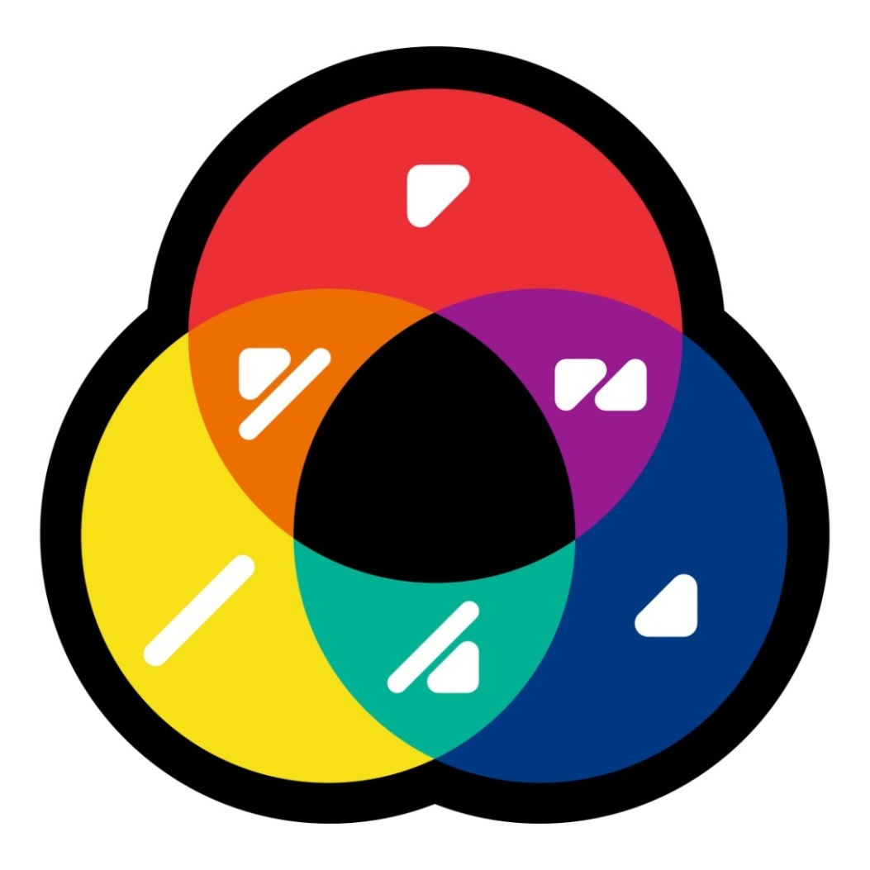
The colour code for colour blind people
Based on the primary colours (cyan, magenta, yellow) and their decomposition into secondary colours.
Black and white were added in order to distinguish dark and light colours.

Slide 12
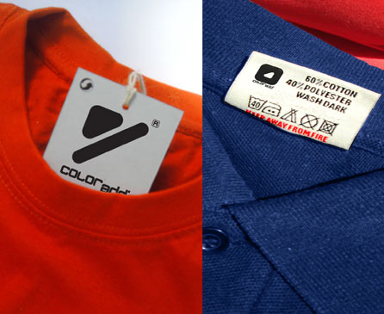
Examples
Colour blind people look at an object, e.g. a piece of clothing, and by means of the symbols he is able to distinguish the colours.

Slide 13
ColorAdd® applications
Transport
(signals for trains, subway)
Education
Health system
Textile industry

Slide 14
Wheelchair
‘Low cost’

Slide 15
WheelChair “low-cost”
The prototype was created by the Instituto Politécnico de Leiria (IPL).
The wheelchair is controlled by the movement of the eyes and the voice of its owner.
An analyse of the sourrounding by a webcam helps to avoid accidents.

Slide 16
Items used for the prototype:
NoteBook 'low cost‘
data acquisition board
two motors
two wheels
headset(microphone and headphones)
two 'webcams‘
helmet

Slide 17
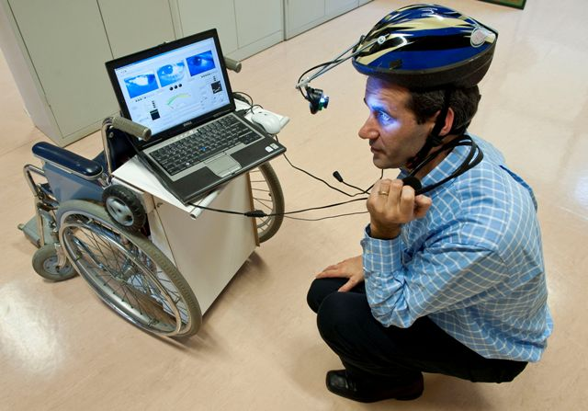

Slide 18
Costs of the prototype
Supposed cost is between 10.000€ – 30.000€
Low cost models guarantees a low price ≈ 2.500€
At the moment, the designers are trying to change the design in order to become a more mobile gadget.

